Slide 1
User Interface Design
用户界面设计
主讲教师：张钢 教授
Blog: http://blog.sina.com.cn/tjugzhang
Assignment mailbox: tju_ui@163.com
Email: gzhang@tju.edu.cn
2013年

Slide 2
TWO Cognetics and the Locus of Attention
第二章 认知学和关注点
Know thyself.
了解你自己。
-Inscription at Delphic Oracle

Slide 3
为什么要了解认知学？
人和计算机之间的信息反馈圈
使用者
认知过程
动作反应
人
信息输入
信息输出
信息输入
机器
显示提示
机器
操作控制

Slide 4
Ergonomics and Cognetics: What We Can and Cannot Do
人机工程学和认知学：我们能做的和不能做的
Ergonomics takes into account the statistical nature of human variability.
人机工程学考虑人类差别的统计特性
The study of the applicable, engineering scope of our mental abilities is cognitive engineering, or cognetics.
对于我们心智能力上适用的工程范围的研究称为认知工程或认知学

Slide 5
Ergonomics 人机工程学
Ergonomics is the science of designing the job, equipment, and workplace to fit the worker.
人机工程学是设计工作、设备和工作场所适合于工作者的科学
Proper ergonomic design is necessary to prevent repetitive strain injuries, which can develop over time and can lead to long-term disability.
  避免由于不断重复带来的伤害

Slide 6
Ergonomics 人机工程学
Ergonomics is the scientific discipline concerned with designing according to human needs, and the profession that applies theory, principles, data and methods to design in order to optimize human well-being and overall system performance.
  是科学的学科和职业
The field is also called human engineering, and human factors.
  人工程和人因（工程）

Slide 7
Ergonomics 人机工程学
Five aspects of ergonomics:
人机工程学的五个方面
  Safety安全
  Comfort舒适
  Ease of use易用
  Productivity/performance生产率/性能
  Aesthetics美观

Slide 8
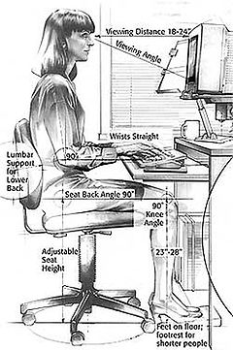
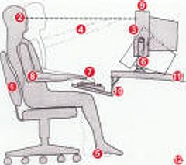
Ergonomics 人机工程学

Slide 9

Ergonomics 人机工程学

Slide 10
Cognitive engineering认知工程
精神上的人机工程学就是认知工程或认知学。关于认知工程的描述如下：
Cognitive engineering is the practical application of cognitive science, especially as it involves computers, and it is the art of building tools to help people think.
认知工程是认知科学的实际应用，并且认知工程是构建帮助人们思考的工具的艺术（技术）

Slide 11
Cognitive engineering认知工程
Cognitive engineering is broader than artificial intelligence because its goal is to build tools, not just models.
认知工程比人工智能更宽泛，因为它的目标是构建工具而不仅仅是模型

Slide 12
Cognitive engineering认知工程(续)
Cognitive engineering is an interdisciplinary approach to the development of principles, methods, tools, and techniques to guide the design of computerized systems intended to support human performance.
认知工程是一种跨学科的方法，所发展的原理、方法、工具和技术就是为了指导旨在支持人的效率的计算机系统的设计

Slide 13
Cognitive engineering认知工程(续)
Cognitive engineering is a multidisciplinary endeavor concerned with the analysis, design, and evaluation of complex systems of people and technology.
认知工程是多学科的努力，关注于人和技术的复杂系统的分析、设计和评价

Slide 14
Cognitive engineering认知工程(续)
Cognitive engineering combines knowledge and experience from cognitive science, human factors, human-computer interaction design, and systems engineering.
认知工程结合了来自认知科学、人因、人机交互设计和系统工程的知识和经验

Slide 15
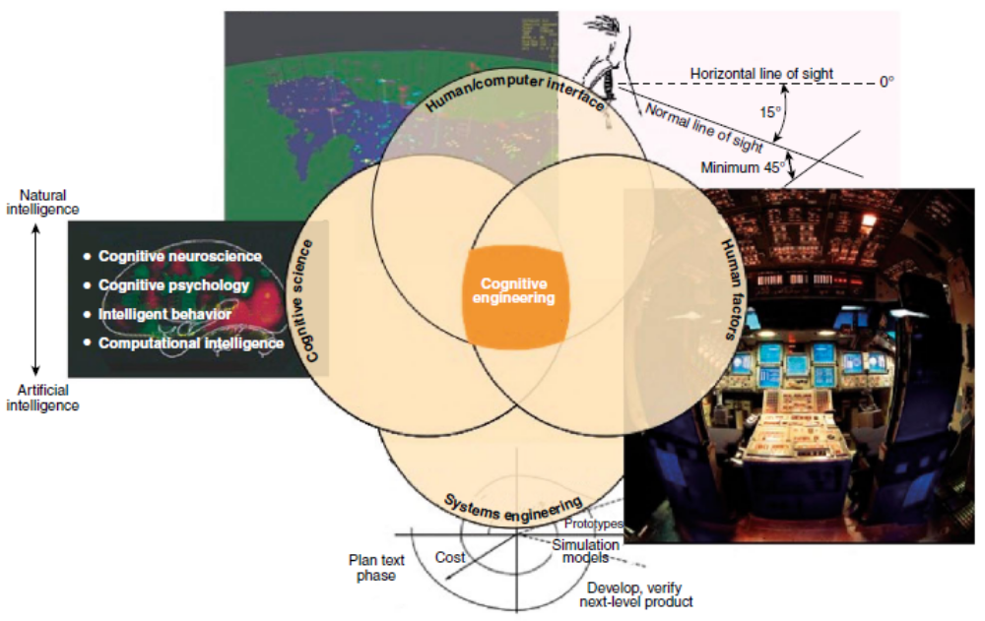
Cognitive engineering认知工程(续)

Slide 16
作业3：阅读
Cog_eng_def.pdf
提交读书报告
  浏览全文
  精读一部分
  写了解的和学到的东西

Slide 17
Ergonomics and Cognetics: What We Can and Cannot Do
人机工程学和认知学：我们能做的和不能做的
Use a machine or a tool in accord with its strengths and limitations, and it will do a good job for you.
使用机器或工具时能扬长避短，将给你的工作带来便利

Slide 18
Ergonomics and Cognetics: What We Can and Cannot Do
人机工程学和认知学：我们能做的和不能做的
Design a human-machine interface in accord with the abilities and foibles of humankind, and you will help the user to not only get the job done but also be a happier, more productive person.
根据人类的能力和缺点（弱点）设计人机界面，不仅能帮助用户完成工作，而且能使他成为愉快高效的人

Slide 19
Ergonomics and Cognetics: What We Can and Cannot Do
人机工程学和认知学：我们能做的和不能做的
We understand our physical limitations relatively well.
我们相对比较了解身体上的局限性
  因为机械装置和我们有身体上的交互
We must master an ergonomics of the mind if we want to design good interfaces.
如果想设计好的界面，必须掌握精神上的人机工程学
  因为计算机给人以心智上的帮助(the aid of intellectual)

Slide 20
Ergonomics and Cognetics: What We Can and Cannot Do
人机工程学和认知学：我们能做的和不能做的
We are often not aware of mental limitations, although these limitations are inherent in every human.
我们往往不知道心智上的局限，尽管这些局限天生就有
We are often blind to our own mental limits.
我们往往对心智上的局限视而不见

Slide 21
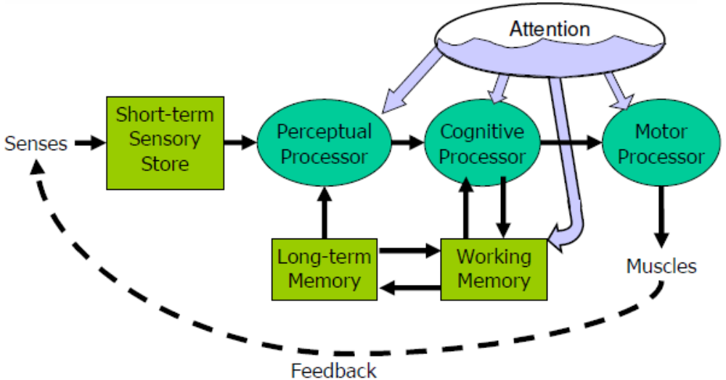
Ergonomics and Cognetics: What We Can and Cannot Do
人机工程学和认知学：我们能做的和不能做的
Human Information Processing
  by Card, Moran, and Newell

Slide 22
Short-Term Sensory Store短期感官存储
Visual information store视觉信息存储
  encoded as physical image
  size ~ 17 [7-17] letters
  decay ~ 200 ms [70-1000 ms]
Auditory information store听觉信息存储
  encoded as physical sound
  size ~ 5 [4.4-6.2] letters
  decay ~ 1500 ms [900-3500 ms]

Slide 23
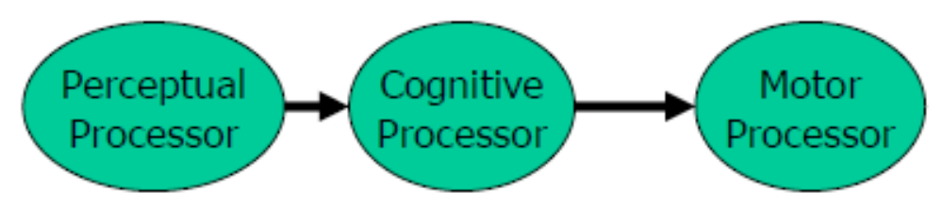
Processors处理器
Processors have a cycle time
  感觉处理器周期：Tp ~ 100ms [50-200 ms]
  认知处理器周期： Tc ~ 70ms [30-100 ms]
  运动处理器周期： Tm ~ 70ms [25-170 ms]
Fastman may be 10x faster than Slowman

Slide 24
Attention and Perception注意和感觉
Spotlight metaphor聚光灯隐喻
  Spotlight moves serially from one input channel to another
Visual dominance视觉优势: easier to attend to visual channels than auditory channels
All stimuli within spotlighted channel are processed in parallel
聚光灯通道内的所有刺激物被并行处理

Slide 25
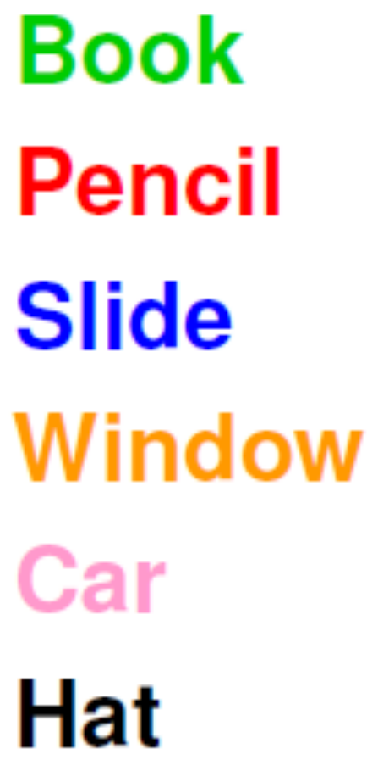
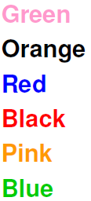
Attention and Perception注意和感觉
Say the Colors of These Words Aloud
Now Do It Again

Slide 26
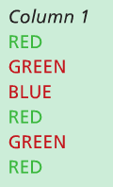
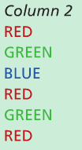
Attention and Perception注意和感觉
Say the Colors of These Words Aloud
Now Do It Again

Slide 27
Working Memory (WM)工作记忆
Small capacity: 7 ± 2 “chunks”
Fast decay (7 [5-226] sec)
Maintenance rehearsal fends off decay
Interference causes faster decay
“Chunk”: unit of perception or memory
Chunking depends on presentation and what you already know
  B M W R C A A O L I B M F B I
  BMWR CAA OLIB MFBI
  BMW RCA AOL IBM FBI
3-4 digit chunking is ideal for encoding unrelated digits

Slide 28
Long-term Memory (LTM)长期记忆
Huge capacity
Little decay
Elaborative rehearsal moves chunks from WM to LTM by making connections with other chunks

Slide 29
Ergonomics and Cognetics: What We Can and Cannot Do
人机工程学和认知学：我们能做的和不能做的
复述：
  8位的固定电话号码
  11位的手机电话号码
  18位的身份证号码
停几秒钟再复述
复述：
  8位的杂乱数据
  11位的杂乱数据
  18位的杂乱数据
停几秒钟再复述
用一条直线将一个四边形分成三个三角形

Slide 30
Ergonomics and Cognetics: What We Can and Cannot Do
人机工程学和认知学：我们能做的和不能做的
从图中看到了什么？
感官对世界的认识带有主动性

Slide 31
Ergonomics and Cognetics: What We Can and Cannot Do
人机工程学和认知学：我们能做的和不能做的
Much of difficulty is due to poor interface design 很多困难来自于不恰当的界面设计
  Rather than to any complexity inherent to the task 不是任务本身的复杂性
  Rather than to any lack of effort on the part of users 不是用户不够努力
  Rather than to any lack of intelligence on the part of users 不是用户不够聪明

Slide 32
Ergonomics and Cognetics: What We Can and Cannot Do
人机工程学和认知学：我们能做的和不能做的
炉灶布局问题
方案1
方案2
不是我们不够聪明！

Slide 33
Ergonomics and Cognetics: What We Can and Cannot Do
人机工程学和认知学：我们能做的和不能做的
炉灶布局问题可能只是带来一些使用的不便
有些问题可能就不只是不便了，而是严重意外和重大伤亡
  美国三里岛核电站核泄漏
    20万人撤离（1979.3.28）
  苏联切尔诺贝利核电站核泄漏
    13.5万人疏散（1986.4.26）
设计缺陷+操作失误=重大事故

Slide 34
Ergonomics and Cognetics: What We Can and Cannot Do
图a
图b
+
=
图a是核电厂安全参数（冷却水）显示
图b是衍生特性和结构优势效应的测试

Slide 35

Ergonomics and Cognetics: What We Can and Cannot Do
人机工程学和认知学：我们能做的和不能做的
作业4：
就图标太小、不易操作的问题提出你的解决办法，并尝试实现你所提出的解决办法

Slide 36
Cognitive Conscious and Unconscious 认知意识和潜意识
Conscious 意识（有意识的）
Unconscious 潜意识（无意识的）
  Psychology and Philosophy 心理学和哲学领域
Cognitive conscious 认知意识
Cognitive unconscious 认知潜意识
  Engineering context 工程情境中
Empirical conscious 经验意识
Empirical unconscious 经验潜意识
  More accurate terms 更确切的术语

Slide 37
Conception of Consciousness
意识的概念
广义的意识概念
  意识是赋与现实的心理现象的总体，是作为直接经验的个人的主观现象
狭义的意识概念
  意识是指人们对外界和自身的觉察与关注程度

Slide 38
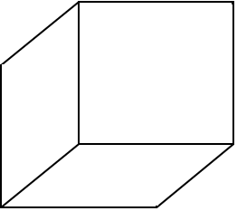
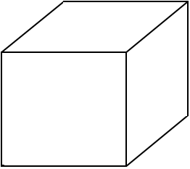
Conception of Consciousness
意识的概念
能看到两种透视立方体
两种透视立方体会自动变换
耐克尔立方体

Slide 39
Conception of Consciousness
意识的概念
能看到两种东西：老鼠、男子
每次只能看到一种东西
两种东西会自动变换

Slide 40
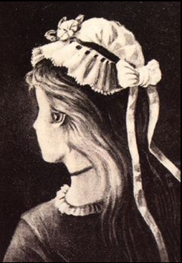
Conception of Consciousness
意识的概念
少女 or
女巫

Slide 41


Conception of Consciousness
意识的概念

Slide 42
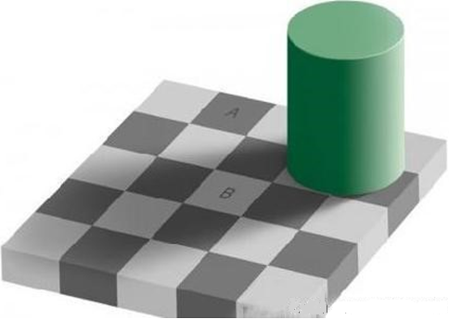
Conception of Consciousness
意识的概念

Slide 43
Cognitive Conscious and Unconscious 认知意识和潜意识
Unconscious mental processes are those of which you are not aware at the time they occur.
潜意识精神过程是指那些发生时你并没有意识到的过程
  潜意识的一种定义
  例子：
    你名字（拼音）的最后一个字母是什么？
    走错路，口误等

Slide 44
Cognitive Conscious and Unconscious 认知意识和潜意识
Understanding that these two distinct sets of limited mental abilities and understanding how they work in relationship to human-machine interfaces is essential to designing interfaces.
了解意识和潜意识这两种截然不同的有限的精神能力，并搞清楚它们作用于人机界面的机理，对设计界面非常必要

Slide 45
Cognitive Conscious and Unconscious 认知意识和潜意识
A stimulus can trigger the migration of not only an item of information but also a sensation, a feeling, or another aspect of your memory or knowledge from the unconscious to the conscious.
刺激不仅能激发信息项的移动，而且还能触发感觉、感情或者记忆和知识的其它方面从潜意识到意识的转移
  注意你的衣服什么地方紧，什么地方松。

Slide 46
Cognitive Conscious and Unconscious 认知意识和潜意识
A sudden noise or other unexpected event can pull your attention away from what you are doing, reading book, and to the question of what caused the sound.
突发的噪声或其它意外事件会将你的注意力从正在做的事情（读书）上转到什么发出声音的问题上
After you return to reading, your knowledge of the event will move from the cognitive conscious to the cognitive unconscious.
当你接着阅读时，这个事件的知识将从意识转到潜意识

Slide 47
Cognitive Conscious and Unconscious 认知意识和潜意识
For the time being picture the conscious and the unconscious as separate compartments.
暂时将意识和潜意识描绘为互相独立的隔间
These compartments are more than just different places or states for storing thoughts or memories: They have different ways of interacting with the world and with concepts.这些隔间就是存储思想和记忆的不同地方和状态：它们用不同的方式与世界和概念交互

Slide 48
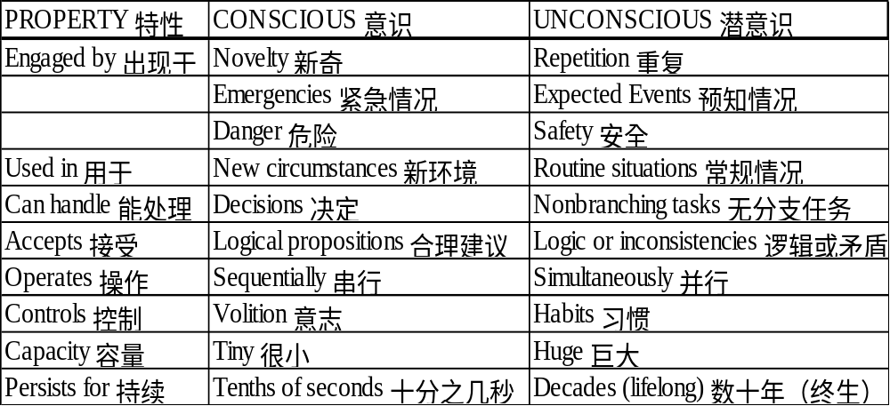
Cognitive Conscious and Unconscious 认知意识和潜意识
Properties of the cognitive conscious and the cognitive unconscious
认知意识和认知潜意识的特性

Slide 49
Cognitive Conscious and Unconscious 认知意识和潜意识
Properties of the cognitive conscious and the cognitive unconscious
认知意识和认知潜意识的特性
  The cognitive conscious operates sequentially and can consider only one question or control only one action at a time.
  认知意识顺序运行，一个时刻仅能考虑一个问题或控制一个动作
The conscious is invoked in branching tasks.
意识是被分支任务引起的

Slide 50
Cognitive Conscious and Unconscious 认知意识和潜意识
It is sometimes difficult to distinguish a branching task from a nonbranching task.
有时很难分清楚分支任务和无分支任务
  E.g., braking for a traffic light may be either.
  例如，遇到交通信号灯时刹车
    红灯：踩刹车板，由认知潜意识控制的无分支任务
    绿灯正变成黄灯：或走或停，由认知意识控制的分支任务
With repetition, your execution of the task may become nonbranching and automatic.
如此重复，这项任务就可能变成无分支和自动的了
  习惯能够使分支任务变成无分支任务

Slide 51
Locus of Attention 关注点
When you are awake and conscious, your locus of attention is a feature or an object in the physical world or an idea about which you are intently and actively thinking.
当你清醒并且有意识的时候，你的关注点是外界的一个特征或对象，或是你正在专心和主动思考的一个想法

Slide 52
Locus of Attention 关注点
You are concentrating on at most one entity which is your locus of attention.
人的精力最多只能集中在一个实体上，这就是关注点
  Object 对象
  Feature 特征
  Memory 记忆
  Concept 概念
You see and hear much more than whatever is the locus of your attention.
你的所见所闻远远超出关注点所在
  荧光灯(fluorescent light)的嗡嗡声(buzz)

Slide 53
Locus of Attention 关注点
Perceptions do not automatically become memories.
感觉不能自动变成记忆
Most perceptions are lost after they decay.
大部分感觉在衰退后就丢失了
  Visual perceptions decay in typically 200 milliseconds.
  视觉感知衰退的典型时间200毫秒
  Auditory perceptions decay in typically 1500 milliseconds.
  听觉感知衰退的典型时间1500毫秒

Slide 54
Locus of Attention 关注点
One implication for interface design
对界面设计的启示
  You cannot assume that, because someone has seen or heard a particular message 5 seconds earlier, that person will remember its wording.
  不能假设5秒前听过或看过的消息，现在还会记住
  Apply the information immediately
  立即使用这个消息
  Keep the message displayed until it is no longer needed 一直显示这个消息，直到不再需要为止

Slide 55
Locus of Attention 关注点
英国的一次列车相撞事故就是因为减速信号灯的设置问题导致的
最初
减速信号
列车
后来
火车站
减速信号
列车
现在
减速信号
火车站
列车

Slide 56
Formation of Habits
习惯的形成
When you perform a task repeatedly, it tends to become easier to do.
当重复完成某个任务时，总是越来越好做
With repetition your competence becomes habitual, and you can do the task without having to think about it.
由于重复，你的能力变成了习惯，并且你根本不用想就能做到
  Working a typewriter by touch 打字（盲打）
  Playing piano 弹钢琴
  Juggling 杂耍
  Riding a bicycle 骑自行车

Slide 57
Formation of Habits
习惯的形成
Any habit is a surrender of detail control
任何习惯都是放弃对细节的控制
  我们刚学骑自行车时都挨过摔，为什么？
  很难想象开汽车时还要仔细想着每项操作和每个动作
Persistent use of any interface will cause you to develop habits that you will find yourself unable to avoid.
持续使用某种界面会让你养成难以放弃的习惯
  不要让用户养成会引起麻烦的习惯

Slide 58
Formation of Habits
习惯的形成
We must design interfaces that
我们要设计的界面：
  Deliberately take advantage of the human trait of habit development
  特别留意利用人们习惯形成的特性
  Allow users to develop habits that smooth the flow of their work
  使得用户养成顺利进行工作的习惯

Slide 59
Formation of Habits
习惯的形成
The ideal humane interface would reduce the interface component of a user’s work to benign habituation.
理想的人本界面应该使用户工作的界面部件与良好的习惯相一致
Many of the problems that make products difficult and unpleasant to use are caused by human-machine design that fails to take into account the helpful and injurious properties of habit formation.
许多导致产品难用或不愿用的问题都出在人机设计未能考虑习惯形成的有利和有害的特性

Slide 60
Formation of Habits
习惯的形成
One notable example is the tendency to provide many ways of accomplishing the same task.
值得注意的事例是，提供多种方法完成同一任务这种趋势
  哪些事例？
Having multiple options can shift your locus of attention from the task to the choice of method.
有了多种选项反而会将你的关注点从要完成的任务上移到方法的选择上
  为什么？

Slide 61
Formation of Habits
习惯的形成
You cannot often break a habit by an act of volition.
你不能经常通过意志行为打破一种习惯
As often or as fiercely as you tell yourself that you will not perform the habitual action, you may not always be able to stop yourself.
尽管你可以频繁地或强烈地告诉你自己不去做习惯的动作，你也并不是总能阻止自己
  口头禅、习惯动作等

Slide 62
Formation of Habits
习惯的形成
You cannot undo a habit by any single act of willpower, only a time-consuming training process can undo a habit.
你不能通过意志力的任何单一动作消除一个习惯，惟有长时间的训练过程才能消除它
  汽车油门(accelerator)与刹车(brake)对调，增加红灯提示，但肯定会出错，特别是在紧急情况下

Slide 63
Formation of Habits
习惯的形成
A designer can lay a nasty trap by permitting to run two or more heavily used applications that differ in only a handful of often-used details.
设计者可能会布下危险的陷阱，使两个或多个经常要使用的应用程序仅在少数常用的细节上有些区别
  MS Word和MS PowerPoint的插入页码功能

Slide 64
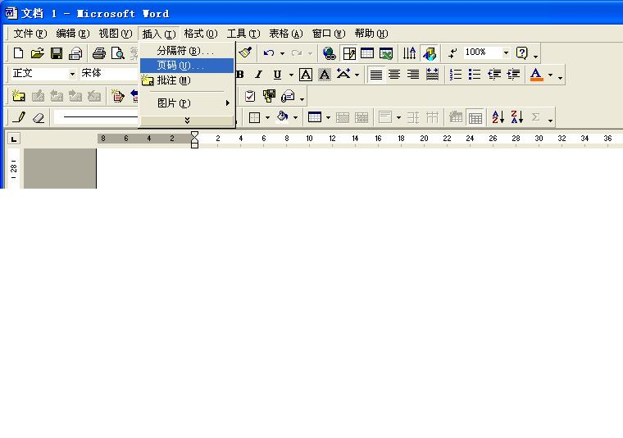
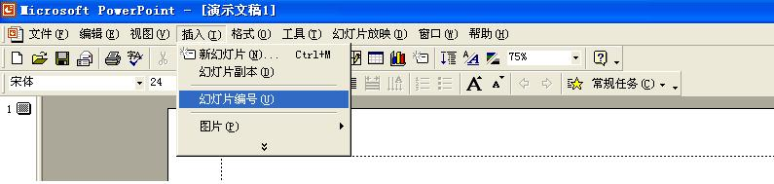
Formation of Habits
习惯的形成

Slide 65
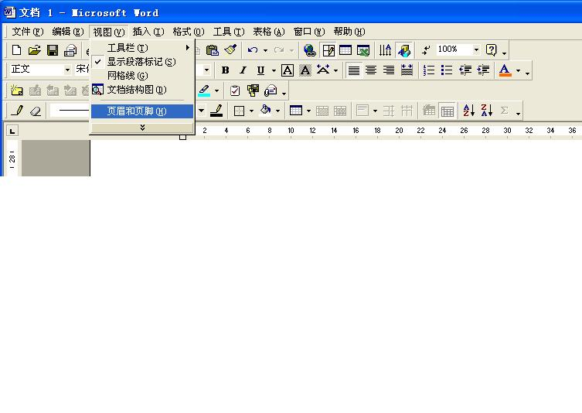
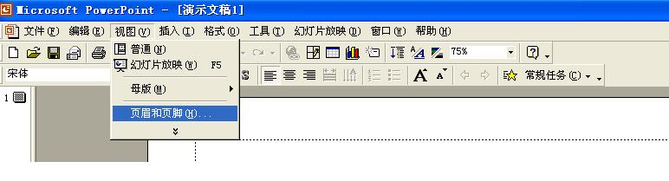
Formation of Habits
习惯的形成

Slide 66

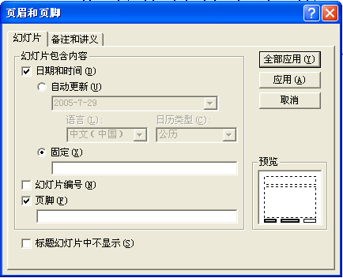
Formation of Habits
习惯的形成

Slide 67
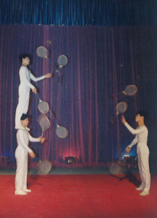


Execution of Simultaneous Tasks
并发任务的执行
Any task that you have learned to do without conscious thought has become automatic.
任何已经学会不经刻意思考就能去做的任务已经变成自动的任务
  哪些任务？

Slide 68
Execution of Simultaneous Tasks
并发任务的执行
Automaticity enables you to do more than one activity at a time: All but at most one of the tasks that you perform simultaneously are automatic.
自动性使你可以同时完成多项活动，其中至多有一项不是自动的
  Walk without tripping
  走着路但不会绊倒
  Eat a snack without choking
  吃着快餐但不会噎着
  Think through a mathematics problem to a satisfactory conclusion.
  思考着数学问题并得到满意的结论

Slide 69
Execution of Simultaneous Tasks
并发任务的执行
The one that not automatic is the one that most directly involves your locus of attention.
那项非自动的任务就是与你的关注点最直接相关的那项任务
When you do two tasks simultaneously, neither of which is automatic, your performance on each task degrades.
当你同时完成两项任务时，而且这两项都不是自动的，则你在每项任务上的效能都会下降
  称为干涉(interference)

Slide 70
Execution of Simultaneous Tasks
并发任务的执行
The more predictable, automatic, and unconscious a task becomes, the less it will degrade or compete with other tasks.
某项任务越是可预知的、自动的、且是无意识的，它的性能下降或者与其他任务的竞争就会越少

Slide 71
Execution of Simultaneous Tasks
并发任务的执行
Equally important as the fact that you cannot be conscious of more than one task at any moment is the realization that humans cannot avoid developing automatic responses.
与你不能在任意时刻意识到多个任务的事实同样重要的是人类不能避免形成自动响应的现实（英p21;中p20）
  不能同时意识到多个任务
  不能避免形成自动响应

Slide 72
Execution of Simultaneous Tasks
并发任务的执行
No amount of training can teach a user not to develop habits when she uses an interface repeatedly.
当用户重复使用同一种界面时，再多的训练也不能使她不去形成习惯
That we form habits is part of our fixed mental wiring;
习惯是固定心理连线的一部分
Habit formation cannot be prevented by any act of volition.
习惯的形成不会被任何意志活动所阻止

Slide 73
Execution of Simultaneous Tasks
并发任务的执行
Any sequence of actions that you perform repeatedly will, eventually, become automatic.
任何你重复做的动作序列，最终都会成为自动的
A set of actions that form a sequence also becomes clumped into a single action.
一组形成序列的动作还会集结为一个单一的动作
The inevitability of habit formation has implications for interface design.
习惯形成的必然性对界面设计是有意义的

Slide 74
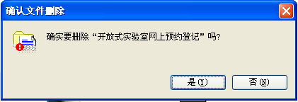
Execution of Simultaneous Tasks
并发任务的执行
例子：广泛接受的删除确认
  “确实要删除吗？” “是” “否”
The system will give you a chance to correct an otherwise irrecoverable error.
系统给你一次机会避免可能发生的不可恢复的错误

Slide 75
Execution of Simultaneous Tasks
并发任务的执行
You can readily make an accidental deletion even when this kind of confirmation is required.
尽管要求做这类确认，还是很容易出现意外删除
原因：
  由于错误相对很少，一般都是在要求确认时选择“是”
  不断的重复，形成了选择“是”的习惯
  选择“是”不再是一个独立的心理操作，而成为删除动作的一部分

Slide 76
Execution of Simultaneous Tasks
并发任务的执行
Any confirmation step that elicits a fixed response soon becomes useless.
任何引起固定响应的确认步骤都会很快变成无用的
Designers who use such confirmations are unaware of the powerful habit-forming property of the cognitive unconscious.
使用这种确认的设计者不知晓认知潜意识中的强大的习惯形成特性

Slide 77
Execution of Simultaneous Tasks
并发任务的执行
Any attempt at an effective confirmation process is necessarily obnoxious because it prevents the user from forming a habitual response.
任何有效的确认过程都必然令人不快，因为它妨碍用户形成习惯性的响应
  To make the required confirmation action unpredictable
  把要求确认的动作做成不可预知的

Slide 78
Execution of Simultaneous Tasks
并发任务的执行
The action that you have requested cannot be undone. It will cause permanent loss of the information in the file. If you are sure you wish to delete the information forever, type backward the tenth word in this box.
你请求的动作不可撤销，它将引起文件中信息的永久丢失。如果你确定要永久删除此信息，请键入此框中倒数第十个单词。
看了这样的对话感觉如何？
实际效果如何？

Slide 79
The action that you have requested cannot be undone. It will cause permanent loss of the information in the file. If you are sure you wish to delete the information forever, type backward the tenth word in this box.
你请求的动作不可撤销，它将引起文件中信息的永久丢失。如果你确定要永久删除此信息，请键入此框中倒数第十个单词。
Such measures create a new locus of attention
这样的方法建立了新的关注点
  提示信息成了关注点，关注点发生了转移
The user is not attending to the correctness of their prior response
用户可能会忽视其先前响应的正确性
  关注点的转移，使用户专心于阅读提示信息并按提示的方法进行操作，不该操作的也操作了！
The purposes of both the confirmation and the user are frustrated
确认过程和用户的目的均会因此而落空

Slide 80
Execution of Simultaneous Tasks
并发任务的执行
If the rationale for performing an irreversible act was flawed from the outset, no warning or confirmation method can prevent the user from making a mistake.
如果形成不可撤销动作的基本原理从一开始就有破绽的话，没有什么警告或确认方法能够阻止用户犯错误
！
？

Slide 81
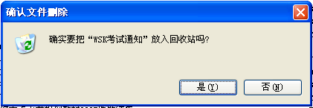
Execution of Simultaneous Tasks
并发任务的执行
A more effective strategy is to allow user to undo an erroneous command.
更为有效的策略是允许用户撤销错误命令
  Windows的回收站

Slide 82
作业5
虽然删除等操作可以用回收站或回退的方式挽回用户的操作错误，但是在实际的操作中还有其它类型的操作，比如：关闭一个网页、关闭邮箱、退出已经登录的系统等，可能并不能用回收站或回退的方式挽回用户的错误操作，那么在这种情况下给用户一次确认他的操作的机会是不是有必要呢？会不会有效呢？针对这种情况你有什么可行的建议？

Slide 83
Singularity of the Locus of Attention
关注点的单一性
An essential fact about your locus of attention is that there is but one of them.
有关关注点的基本事实是，它有且仅有一个
This observation underlies the solution of numerous interface problems.
这一发现奠定了解决诸多界面设计问题的基础

Slide 84
Singularity of the Locus of Attention
关注点的单一性
When people are asked to monitor a demanding stream of information, they are largely unconscious of alternative streams of information presented at the same time, even to the same sensory organ.
当人们被要求去监视一个需要的信息流时，他们很大程度上不会意识到同时显现的其他信息流，即便是对于相同的感官
  电视播报气象预报的同时播出大量广告，不是看不见广告，就是看不见气象预报
  Absorption kills 101 people 专注杀了101人

Slide 85
Singularity of the Locus of Attention
关注点的单一性
The more intensely you are focused, the more difficult to transit to a different locus of attention, and the greater the stimulus needed to effect such a change.
你越是精力集中，越难以转到其它关注点，也就需要更大的刺激来促成这种改变
When we are completely absorbed by a task, we cease to monitor our environment.
当你完全投入一项任务时，就不关注（停止监视）周围的环境了
  专心阅读时
  深思问题时

Slide 86
Singularity of the Locus of Attention
关注点的单一性
The use of a computer is often so stressful and difficult that a user will become absorbed in working on the computer system, and therefore distracted from the completion of tasks.
计算机的使用常常有如此大的压力和困难，以至于用户不得不专注于控制计算机系统，因而分散了完成任务的注意力

Slide 87
Singularity of the Locus of Attention
关注点的单一性
Our goal is to leave the task as the locus of the user’s attention.
我们的目标是将用户的关注点留在所要完成的任务上
Systems should be designed to allow users to concentrate on their jobs.
系统应该设计成能使用户专心于他们的工作

Slide 88
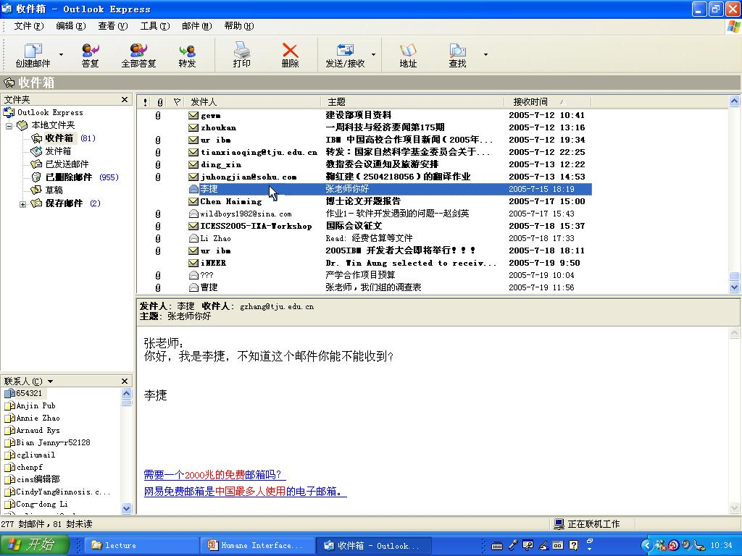
测试

Slide 89

测试

Slide 90
Singularity of the Locus of Attention
关注点的单一性
Interface designers sometimes assume that the user’s locus of attention is the cursor and that changing the cursor’s shape will inevitably command the user’s attention.
界面设计者有时假设用户的关注点就是光标，因而改变光标的形状就必然能操纵用户的注意力
  这个假设未必成立

Slide 91
Singularity of the Locus of Attention
关注点的单一性
The cursor location is a good place to put indicators, but even there, the indicator can go unnoticed.
光标的位置是放置指示器的一个极好位置，但即便是在那，指示器也可能不被注意到。
The shape of the cursor is not the locus of attention; rather, the place or object to which it is pointing may well be.
光标的形状不是关注点，还不如光标所指的位置或对象更为有效

Slide 92
Singularity of the Locus of Attention
关注点的单一性
The more critical the task, the less likely it is for users to notice warnings that alert them to potentially dangerous actions.
任务越重要，越容易忽略提醒危险的警告
A computer warning message is most likely to be missed when it is most important for it not to be missed.
计算机的警告信息越是重要的不可忽略，就越会被忽略掉

Slide 93
Singularity of the Locus of Attention
关注点的单一性
由此得到启示
  To make sure that users cannot make interface operation error
  确保用户不会出错
  To make sure that the effects of any actions are readily reversible rather than simply notifying user about the potential consequences of their actions.
  确保任何动作都可以逆转，而不是简单地提示潜在结果
    其实不需要警告性的消息

Slide 94
Exploitation of the Single Locus of Attention
发掘单一关注点
That people have a single locus of attention is not always a drawback.
人们只有一个关注点并不一定是什么缺陷
  魔术师可以让观众的注意力集中在他的一个手上

Slide 95
Exploitation of the Single Locus of Attention
发掘单一关注点
If we know where the user’s attention is fixed, we can make changes in the system elsewhere, knowing that the changes will not distract the user.
如果我们知道用户的注意力在哪儿，就可以在系统中的其他地方作些改变，并且不会分散用户的注意力
  Canon Cat利用了这一现象

Slide 96
Exploitation of the Single Locus of Attention
发掘单一关注点
Time delays can be masked
时间延迟可以被遮掩
  纸牌游戏中的发牌时间可能较长，但是增加洗牌的声音就会觉得快了
  其原因仍然与关注点有关

Slide 97
时间的感受
我们对时间的感受关键取决于我们正在做些什么
  作报告的人觉得才讲了一会儿（时间过的快），听报告的人已经在偷偷地看表了（时间过得慢）
  主动地做某件事感觉时间过得快，被动地做某件事感觉时间过得慢
有用事件的缺乏使时间得以进入意识，而当某件事能引起我们的兴趣时，我们则全然不会想到时间

Slide 98
时间的感受
对时间速度快慢不同的感受取决于时间本身是否进入了意识。
在一定的时间内所出现的事物比我们所期待的要少时，就会使我们想到时间本身
当我们厌倦时，时间像在慢慢地爬；当我们兴致勃勃时，时间却像在飞
我们更希望：厌倦时时间过快点，兴致勃勃时时间过慢点。

Slide 99
时间的感受
但是另一种情况也被实验所证实
那些在当时感到很枯燥无味的经历，在回忆中显得很短暂
  经历时感到时间长，回忆时感到时间短
那些有趣的经历，在回忆中却显得占有较长的时间
  经历时感到时间短，回忆时感到时间长

Slide 100
时间的感受
对于这种时间矛盾的解释
我们是根据相应的意识内容来估计时间长度的
如果我们得不到新的信息，注意力就会转移到时间上去，时间就像爬一样地慢，但记忆中并未存下什么，因此在回忆中就是空的，（回忆时感到时间短）
如果具有大量信息，我们没有意识到时间，时间因而过得飞快，但在记忆中却储存了丰富的经历，因此在回忆时可以泛起大量的信息，（回忆时感到时间长）

Slide 101
关于时间的感受的题外话
我们生命的主观长度取决于所有曾经在我们的意识之中，随后又在我们的记忆之中存在的东西
以经验作为衡量过去的时间长度的尺子，这是一个主观尺度
没有更多的经历财富，增加的岁数就只不过是空洞的数字而已！

Slide 102
关于时间的感受的有关内容
引自
《意识的限度—关于时间与
意识的新见解》
恩斯特.波佩尔 著
李百涵 等译
北京大学出版社

Slide 103
作业5
收集和分析你认为好的和不好的用户界面，分别写出理由。

Slide 104
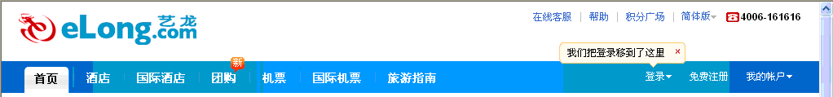



例子
问题分析：
理由说明：

